Slide 1
Presentation Title
Your Name
ECO 202
Instructor Name
Notes:
Choose a title for your presentation.
Include your name, the course name and the assignment name.

Slide 2
Fiscal policy- Introduction
Fiscal policy implies to the significant changes that the government undertakes to the national budget with a view in influencing the nation’s economy. The approach to the economic policy in the country took a laissez faire approach until the great depression hit the economy. Such is illustrated as the government sought to not touch any economic matters as well as hoping to maintain a balanced budget. The major impact of the great depression was the economic downturns that were quite sever. However, the economic stability tended to self-correct hence the laissez faire approach utilized at the time was actually working (O'connor, 2017).
The previous decade was saw great economic depression as a result of the world war II. President Franklin D. Roosevelt instituted fiscal policies in the united states in the New Deal to propel towards economic recovery. However, the first experiments remained insignificantly effective given the fact that great depression experienced in the in 1940s had actually lowered the business expectations drastically (Godley, 2012).

Slide 3
Government spending
The current spending compared to spending habits in the United States pose significant differences.
The federal revenues stood lowest in 1950s in the country, however, the deficit at that point stood at only 1 percent of the country’s GDP.
The major sectors of spending were the Defense which accounted 4% of the GDP (Godley, 2012).
Other parameters that have graced significant spending habits include the social security, health and debt financing.
For the Americans to make significant and drastic changes to the 1950s style taxes then it ought to make quite significant efforts on its spending (Godley, 2012).

Slide 4
Decade of prosperity
The decade 1950s is regarded as the decade of prosperity given the country’s economy grew by 37 percent compared to the other decades.
The median American family saw a spun growth of the purchasing power compared previous decades.
The inflation effect that had previously hit the country particularly during the world war II was brought to minimal as Eisenhower’s persistent bid to create a balanced federal budget.
The unemployment rates in the decade remained a bit to an extend of 4.5% witnessed in the middle of the decade.

Slide 5
Objectives of fiscal policies
Governments across the globe adopt the fiscal policy instruments such as the government expenditure and the taxation so as to create some influence on the economic performance (Godley, 2012).
Promoting sustainable growth in the economy as well as reduction of the poverty levels with the community in a bid to solve the economic crisis such as the great recession as well as during the financial crisis (Kremers,1989).
The governments usually controls the budget allocations through increasing or reducing financial resources hence ensuring the vital goods and services are provided to the citizens.

Slide 6
Desired outcome
The government can use the levels of spending and spending to achieve the desired targets.
The graph illustrates that expectations that prices increasing, the workers are likely to demand higher wages so that their real (Inflation-adjusted) wages are constant hence as inflation shifts in, workers tend to supply labor only in short terme due to higher wages hence resulting to decline in the unemployment rate and vice versa.

Slide 7
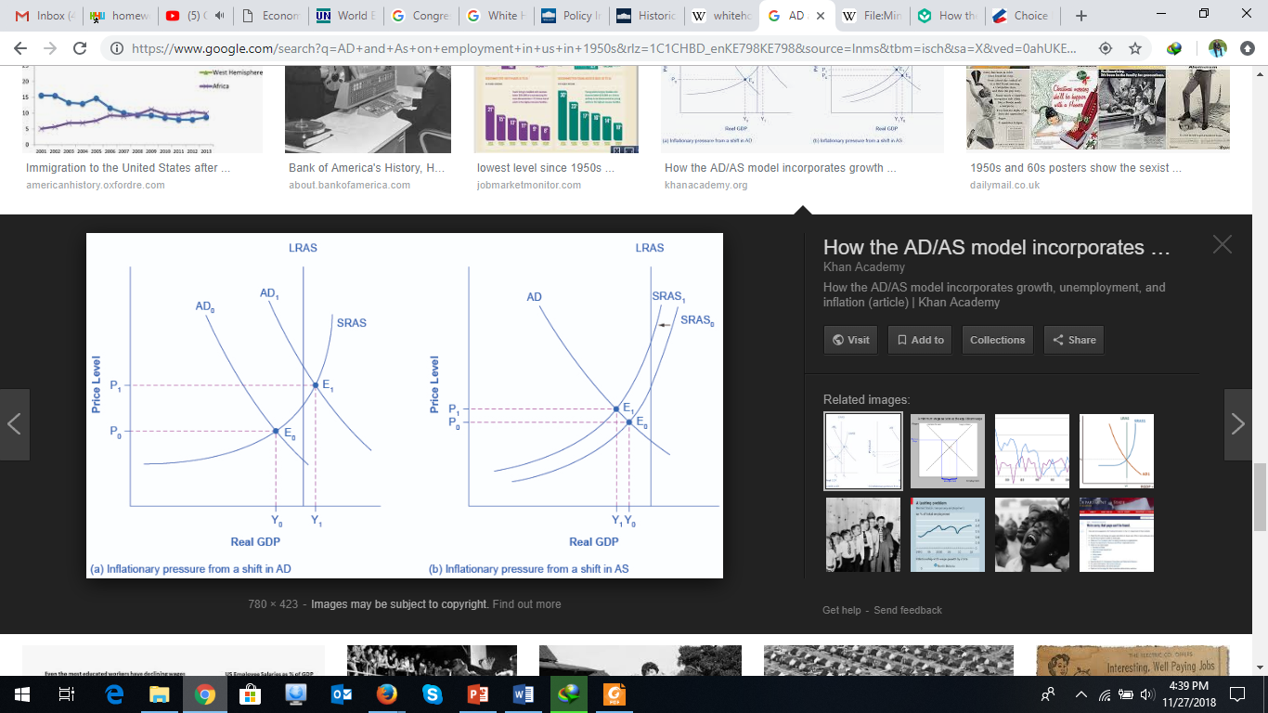
Cont.…
  Example
Spending on infrastructural development projects creates jobs opportunities to the public hence increase the supply of money to the economy hence spurring economic growth and vice versa (Myers, 1970).

Slide 8
References
Kremers, J. J. (1989). US federal indebtedness and the conduct of fiscal policy. Journal of Monetary economics, 23(2), 219-238.
Myers, M. G. (1970). A financial history of the United States. Columbia Univ Pr.
O'connor, J. (2017). The fiscal crisis of the state. Routledge.
Godley, W. (2012). Seven unsustainable processes: medium-term prospects and policies for the United States and the World. In The Stock-Flow Consistent Approach (pp. 216-254). Palgrave Macmillan, London.

